Slide 1
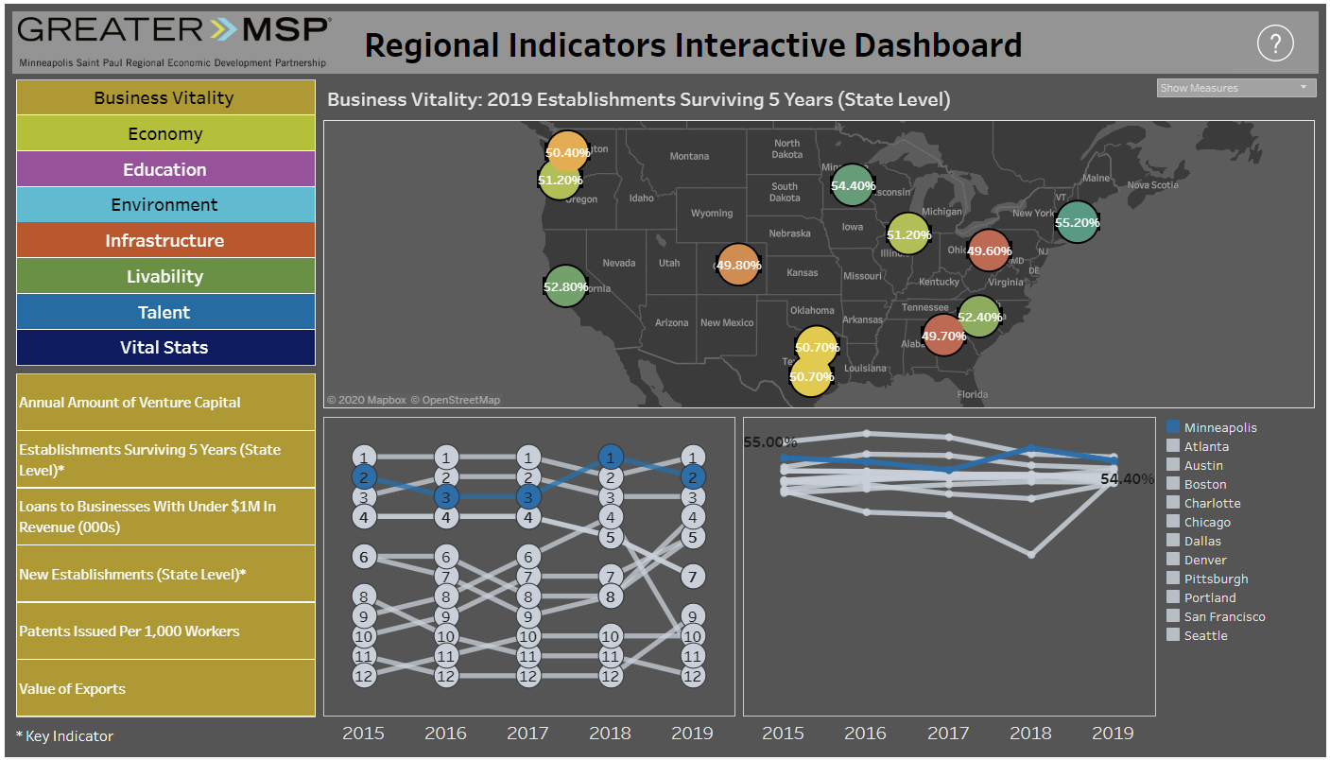
Select Indicators
Select Category, i.e. Business Vitality and then Indicator, i.e. Establishments Surviving 5 Years

Slide 2
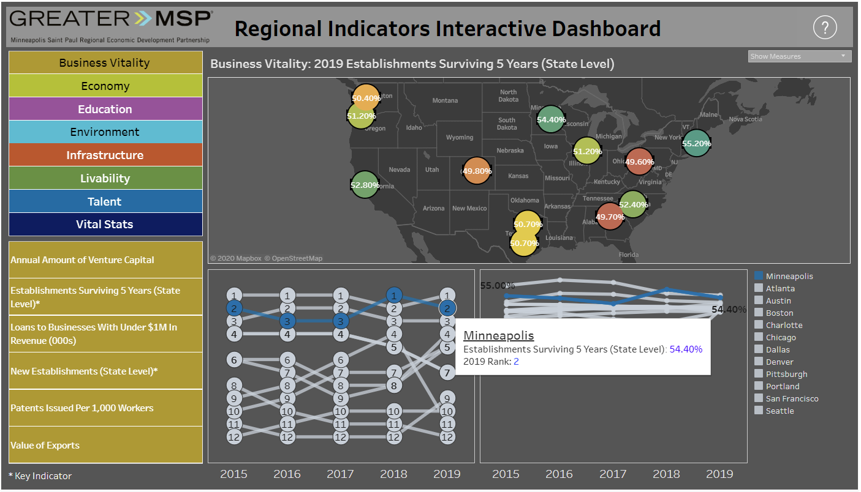
Hover Interactivity
Hover over map, rank chart, or line chart to see more detail

Slide 3
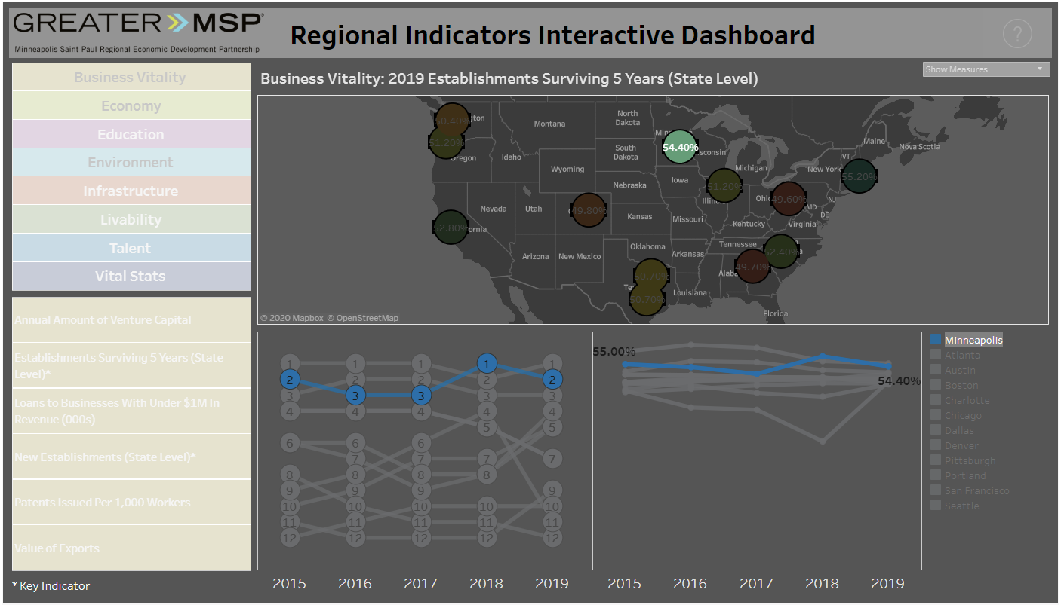
Highlight Interactivity
Select metro area from map or legend to highlight in all visualizations

Slide 4
Map – Current Year
Map dynamically shows most recent year’s measure or rank in the data set

Slide 5
Map – Toggle Display
Toggle between displaying measures or ranks on the map using drop-down menu

Slide 6
Rank Chart – Relative Change
Rank/Bump chart shows the metro’s rank for selected indicator for years in the data set, showing relative change over time

Slide 7
Line Chart – Objective Change
Line chart shows objective change over time for selected indicator

Slide 8
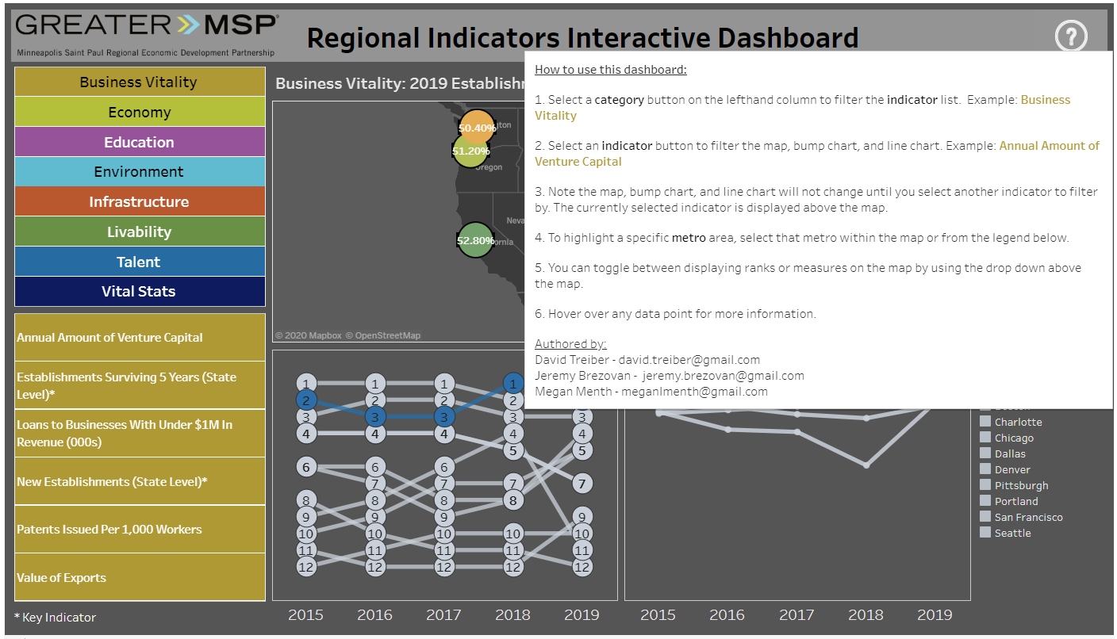
Help
Hover over question mark to show guide on how to use the dashboard

